Slide 1




Ankara Yildirim Beyazit University
Oncology Conference, Damascus
DELAYED DIAGNOSIS OF BREAST CANCER IN NORTHWEST SYRIA
Public Health Institute
Influencing Factors and Associated Negative Outcomes
Dr. Jamil Debel
Master's Thesis
Health Policy and Global Health Program
Thesis Supervisor: Prof. Dr. Salih MOLLAHALİLOĞLU
Co-supervisor: Assoc. Prof. Dr. Nimetcan Mehmet ORHUN
Research Presentation
2025

Slide 2






Background & Context
02
Global Burden
Breast cancer remains the most common cancer among women worldwide, where early diagnosis is the critical determinant for survival rates and treatment success.
The Challenge in LMICs
Low- and Middle-Income Countries face persistent diagnostic delays due to severe resource constraints, lack of screening programs, and limited awareness.
Conflict-Affected Zones
In regions like Northwest Syria, the situation is exacerbated by active conflict, displacement, fragile health infrastructure, and disrupted access to essential care.
Study Goal: To provide context-specific evidence that informs actionable strategies for improving early detection in this unique humanitarian setting.
Early detection saves lives
Dr. Jamil Debel - Master's Thesis Presentation
Ankara Yildirim Beyazit University

Slide 3






Research Problem
03
Fragile Oncology Pathways
Broken health infrastructure amid conflict and border closures disrupts continuity of care and essential drug supply.
Limited Capacity
Severe shortage of screening centers and diagnostic equipment leading to long waiting lists and delayed detection.
Barriers to Access
Low awareness, social stigma, and crippling financial hardship prevent women from seeking timely medical help.
Critical Evidence Gap: Lack of localized data from conflict zones necessitates specific research to guide interventions.
Conflict & Health Fragility
Dr. Jamil Debel - Master's Thesis Presentation
Ankara Yildirim Beyazit University

Slide 4
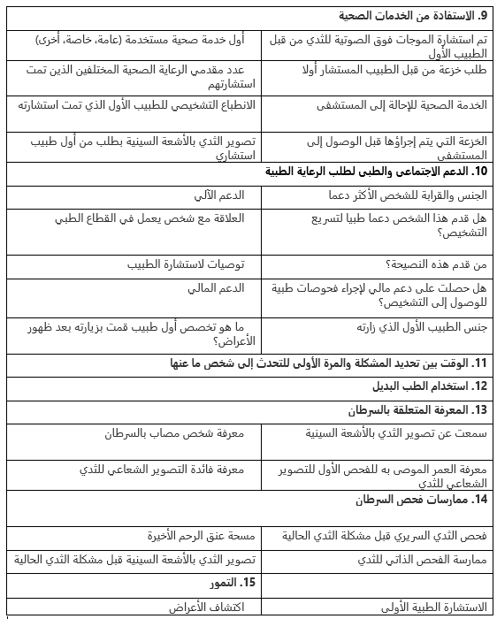
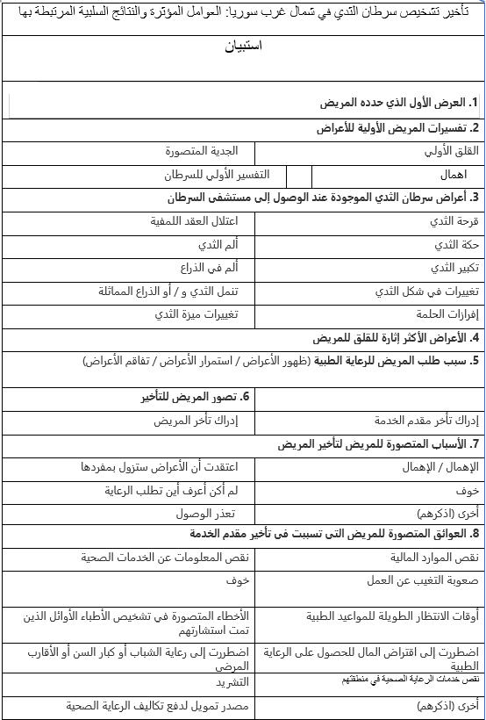
Appendix 4. Questionnaire

Slide 5


Study Objectives
04
GENERAL OBJECTIVE
To investigate the factors contributing to delayed diagnosis and treatment of breast cancer in Northwest Syria and evaluate the associated negative outcomes on patient prognosis.
1
Identify Factors
2
Assess Clinical Impact
Identify socio-demographic, behavioral, and systemic factors significantly associated with diagnostic delays among women in Northwest Syria.
Assess the direct association between diagnostic delay and the clinical stage of breast cancer at first presentation (Stage I vs. II-IV).
3
Measure Timelines
4
Propose Solutions
Quantify key time intervals in the patient pathway: from symptom onset to diagnosis, from diagnosis to oncologist visit, and to treatment initiation.
Develop actionable, multi-level recommendations for individual awareness, health system strengthening, and policy reform to reduce delays.
Dr. Jamil Debel - Master's Thesis Presentation
Ankara Yildirim Beyazit University

Slide 6

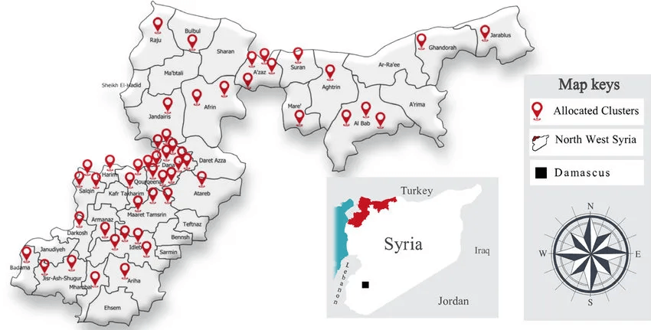





Study Methodology
05
Study Design & Setting
Cross-sectional analytical study conducted across oncology pathways in Northwest Syria (Idlib & Northern Aleppo).
Study Sample
Total participants: n=89. Predominantly female (98.9%) with a mean age of 48 years (SD ±10.7).
Delay Definition
Delayed diagnosis defined as an interval of ≥ 3 months from first symptom recognition to treatment initiation.
Data Collection & Analysis
Structured questionnaire and clinic records. Statistical analysis performed using SPSS (descriptive, comparative, Kaplan-Meier).
Study Location: Northwest Syria
Dr. Jamil Debel - Master's Thesis Presentation
Ankara Yildirim Beyazit University

Slide 7

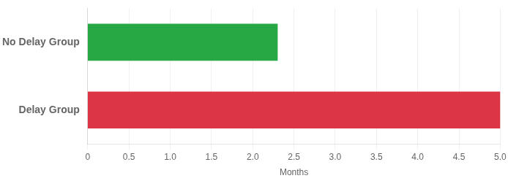
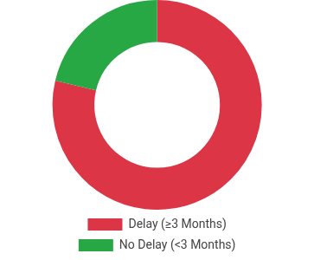
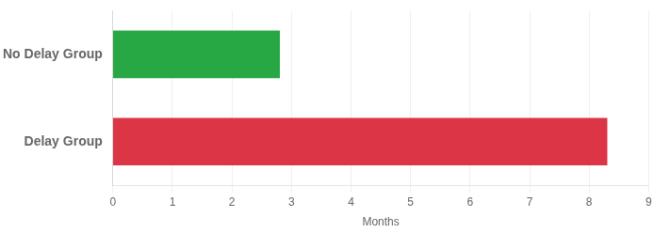
Key Results - Overall Timelines
06
Time to Oncologist: No Delay vs. Delay Group (Months)
Prevalence of Delay (≥3 Months)
Total Time to Chemotherapy Initiation (Months)
Overall Median Time to Oncologist
4.1 Months
Interquartile Range (IQR): 3.0 - 7.2 months
Dr. Jamil Debel - Master's Thesis Presentation
Ankara Yildirim Beyazit University

Slide 8


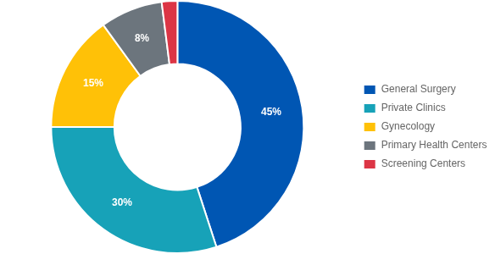
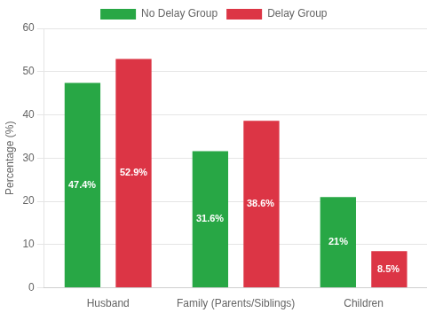
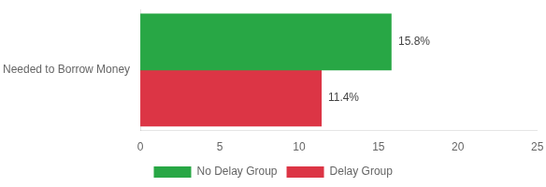
Results – Demographics & Care Pathways
07
Patient Referral Pathways
Key Demographic Indicators
Sample: 89 Patients (98.9% Female)
Mean Age: 48 Years (Similar in both groups)
Household Help: >94% received daily support
Mammography Awareness: Low (~30% in Delay Group)
Primary Source of Support
Financial Burden for Treatment
Dr. Jamil Debel - Master's Thesis Presentation
Ankara Yildirim Beyazit University

Slide 9


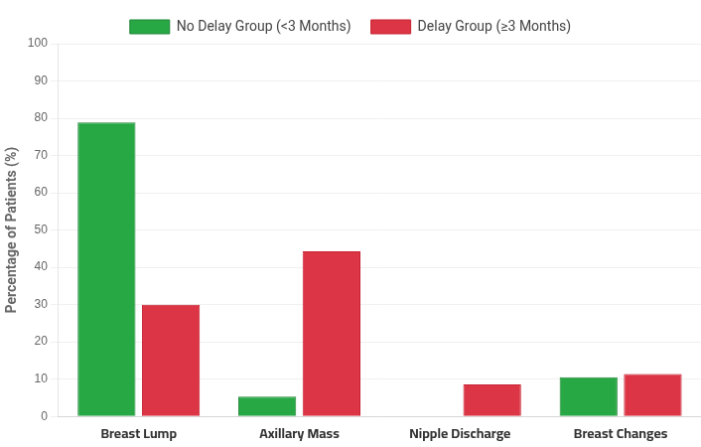


Results – Initial Symptoms Presentation
08
Key Observation
Comparison of Initial Symptoms by Group (%)
Significant difference in initial clinical presentation between groups (p<0.001). Delayed patients were far more likely to present with advanced signs like axillary masses rather than simple breast lumps.
Breast Lump
Most common in "No Delay" group (78.9%) vs. only 30% in "Delay" group
Axillary Mass High Risk Dominant in "Delay" group (44.3%) vs. rare in "No Delay" group (5.3%)
Other Symptoms
Nipple discharge (8.6%) & Breast changes (11.4%) primarily seen in delayed cases
Dr. Jamil Debel - Master's Thesis Presentation
Ankara Yildirim Beyazit University

Slide 10


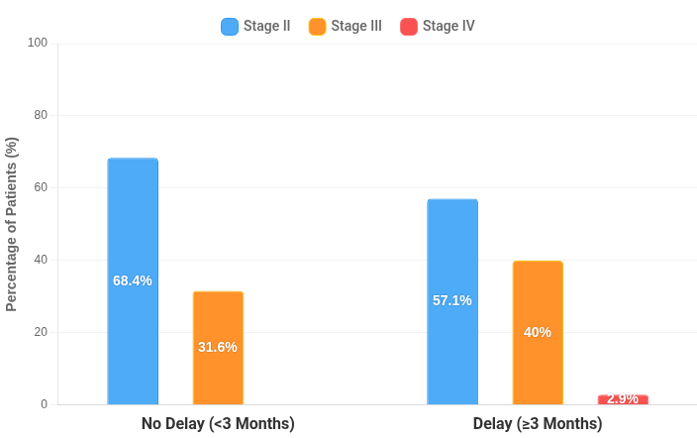
Results – Clinical Stages at Presentation
09
Distribution of Clinical Stages by Delay Status
Critical Finding
Diagnostic delays (≥3 months) are directly associated with more advanced disease presentation. The Delay Group shows a significant shift towards Stage III and the emergence of metastatic Stage IV cases.
ADVANCED STAGES (III + IV)
42.9%
In Delay Group
EARLY STAGE (II)
68.4%
In No Delay Group
Dr. Jamil Debel - Master's Thesis Presentation
Ankara Yildirim Beyazit University

Slide 11


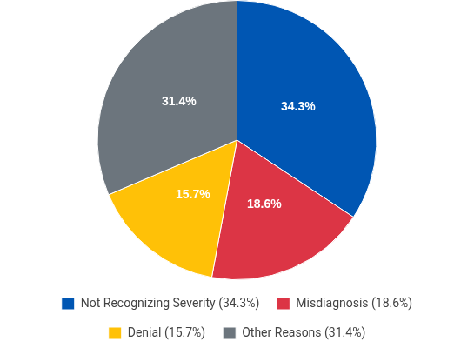

Results - Reasons for Delay
10
Underlying Individual Barriers
Top Self-Reported Reasons
Financial Constraints: Treatment costs and transportation expenses remain significant barriers despite humanitarian aid.
Health Literacy: Low awareness of breast cancer signs leads to dismissing symptoms as benign conditions.
Social Stigma: Fear of diagnosis and social repercussions ("what will people say") causes concealment.
Systemic Constraints
Infrastructure: Limited number of diagnostic centers and shortage of specialists/equipment.
Referral Pathway: Weak coordination, long waiting lists, and border closures disrupting transfer to Turkey.
Diagnostic Capabilities: Absence of advanced tools like PET-Scan leads to staging inaccuracies.
Dr. Jamil Debel - Master's Thesis Presentation
Ankara Yildirim Beyazit University

Slide 12

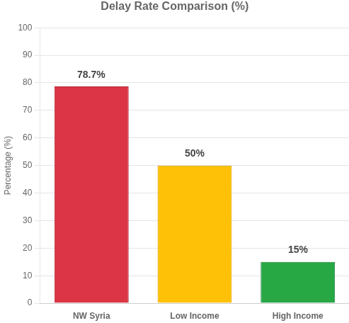


International Comparison & Context
11
Global Benchmarking Matrix
Comparative Visualization
Context / Setting
Delay Rate (>3 Mo)
Median Diagnosis Time
Advanced Stage (III/IV)
Northwest Syria (This Study)
78.7%
4.1 Months
43%
Low-Income Countries
40 – 60%
2 – 6 Months
30 – 50%
Middle-Income Countries
20 – 40%
1 – 3 Months
20 – 30%
High-Income Countries
10 – 20%
< 1 Month
10 – 20%
Damascus Context: Tertiary centers in the capital typically report shorter delays and earlier staging compared to conflict-affected zones, highlighting regional disparities within Syria.
Dr. Jamil Debel - Master's Thesis Presentation
Ankara Yildirim Beyazit University

Slide 13





Discussion: Individual-Level Factors
12
Knowledge Gaps
Psychological Barriers
Profound lack of awareness about screening methods, with ~70% of delayed patients unaware of mammography's role or availability.
Prevalence of denial, intense fear of cancer diagnosis ("that disease"), anxiety about mastectomy, and embarrassment regarding physical exams.
Symptom Appraisal
Social Factors
Misinterpretation of symptoms; many women attributed painless lumps to benign causes (cysts, breastfeeding) and delayed seeking help until pain appeared.
Social stigma surrounding cancer often leads to secrecy. Limited peer discussion means women rely on informal, often incorrect, advice from family.
Delays are not merely due to "negligence" but rooted in complex cognitive, psychological, and social barriers that require targeted educational interventions.
Patient Barriers & Awareness
Dr. Jamil Debel - Master's Thesis Presentation
Ankara Yildirim Beyazit University

Slide 14







Discussion: System-Level Factors
13
Infrastructure Constraints
Scarcity of screening centers and diagnostic hubs, with limited access to interventional radiology facilities across the region.
Workforce Shortages
Critical lack of oncologists, pathologists, and specialized nurses, resulting in uneven access to Multidisciplinary Team (MDT) care.
Equipment Limitations
Absence of advanced imaging like PET-CT scans and constrained pathology capacity affecting diagnostic precision.
Process & Logistics
Weak referral coordination, long waiting queues, and frequent border disruptions hindering patient transfers.
Financial Burden
Significant direct and indirect costs for patients despite humanitarian support, creating economic barriers to sustained care.
Fragile health infrastructure creates systemic delays
Dr. Jamil Debel - Master's Thesis Presentation
Systemic Challenges in Northwest Syria

Slide 15


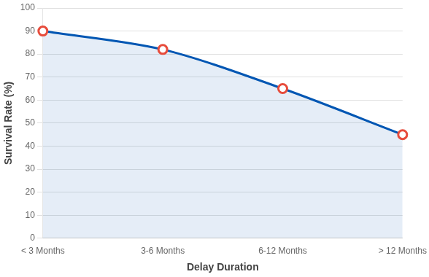



Impact of Delay on Survival and Costs
14
The Clinical Pathway
5-Year Survival Rate Decrease with Diagnostic Delay
Delay leads directly to advanced stage at diagnosis, which results in significantly worse prognosis and decreased survival rates. Every month counts in breast cancer progression.
Global Evidence
Studies consistently show that delays >6 months are associated with a 30-40% decrease in 5-year survival rates. Each additional month of delay increases mortality risk by approximately 10%.
Economic Impact
Treatment for advanced-stage cancer (Stage III/IV) is estimated to be 3-4 times more expensive than early-stage treatment, placing a heavier burden on families and the health system.
In Northwest Syria, 43% of patients present at Stage III or IV
Dr. Jamil Debel - Master's Thesis Presentation
Ankara Yildirim Beyazit University

Slide 16





Strengths and Limitations
15
Study Strengths
Study Limitations
First Focused Study
Sample Size & Design
First dedicated research examining breast cancer diagnostic delays specifically in the conflict-affected Northwest Syria region.
Modest sample size (n=89) and cross-sectional design limit generalizability and causal inference capabilities.
Geographic Scope
Rigorous Methodology
Data collected from a single region, which may not fully represent all conflict zones or government-controlled areas in Syria.
Clear definition of delay (≥3 months) with detailed analysis of specific time intervals (symptom-to-diagnosis, diagnosis-to-treatment).
Survival Data
Holistic Perspective
Lack of longitudinal follow-up means long-term survival outcomes and recurrence rates could not be directly tracked.
Comprehensive multi-level analysis covering individual behaviors, socioeconomic factors, and systemic healthcare barriers.
Dr. Jamil Debel - Master's Thesis Presentation
Ankara Yildirim Beyazit University

Slide 17








Recommendations: Individual Level
16
Targeted Awareness Campaigns
Launch intensive mass media and social media initiatives tailored to local cultural contexts to normalize breast health discussions and symptom recognition.
Community Education & Training
Implement breast self-exam training programs and community health sessions, utilizing simplified, illustrated guides for low-literacy populations.
Psychosocial Support Mechanisms
Establish counseling services and survivor support groups to directly address psychological barriers like denial, fear of diagnosis, and anxiety.
Family Engagement Strategy
Actively engage spouses and family members in education efforts to strengthen the domestic support system and encourage early help-seeking behaviors.
Goal: Empower women to overcome fear and seek care immediately upon symptom discovery.
Education is the first line of defense
Dr. Jamil Debel - Master's Thesis Presentation
Ankara Yildirim Beyazit University

Slide 18





Recommendations: System Level
17
Build Diagnostic Capacity
Establish mammography and ultrasound hubs and develop interventional radiology services to reduce travel burdens.
Develop Human Resources
Implement CME programs and training for oncology nurses, surgeons, radiologists, and pathologists to retain local talent.
Strengthening Infrastructure
Streamline Referrals
Create standardized protocols to fast-track suspicious cases and reduce waiting queues between diagnosis and treatment.
Enhance Data Systems
Implement a unified cancer registry and conduct regular audits of delay times to monitor system performance.
Dr. Jamil Debel - Master's Thesis Presentation
Ankara Yildirim Beyazit University

Slide 19






Recommendations: Policy Level
18
Sustainable Financing
Secure long-term operational budgets, establish strategic donor partnerships, and implement free or discounted treatment schemes to remove financial barriers for patients.
National Strategy & Governance
Develop a comprehensive cancer control plan including organized screening programs, standardized clinical pathways, and mandatory MDT governance for quality assurance.
Regional Integration
Strengthen collaboration with Damascus tertiary centers, establish formal cross-border referral channels, and implement shared training programs and tele-tumor boards.
Integrated National Strategy
Goal: A unified, resilient national oncology framework.
Dr. Jamil Debel - Master's Thesis Presentation
Ankara Yildirim Beyazit University

Slide 20









"From Northwest Syria to Damascus, and from Damascus to all of Syria: breast cancer knows no boundaries."
VISION: A UNITED SYRIA AGAINST CANCER
Unify Protocols
Exchange Expertise
National Oncology Network
Unified Registry
Joint Training
Facilitate Referrals
Dr. Jamil Debel - Master's Thesis Presentation
Ankara Yildirim Beyazit University

Slide 21



Conclusion & Acknowledgements
20
Key Study Conclusions
Acknowledgements
High Delay Prevalence: 78.7% of patients experienced delays ≥3 months, with a median time of 4.1 months to reach an oncologist.
Thesis Supervisors
Prof. Dr. Salih MOLLAHALİLOĞLU
Assoc. Prof. Dr. Nimetcan Mehmet ORHUN
Clinical Impact: Diagnostic delays are significantly associated with advanced presentation (Stages III/IV), leading to poorer prognosis and survival outcomes.
Ankara Yildirim Beyazit University
Complex Barriers: Delays stem from intertwined individual factors (awareness, fear) and systemic issues (infrastructure, borders, costs).
Institutional Support
SAMS (Syrian American Medical Society)
QFFD & QRC (Qatar Fund for Development & Red Crescent)
Path Forward: Addressing this crisis requires multi-level interventions and, crucially, national integration to unify cancer care across Syria.
Idleb Health Directorate
Thank You for Your Attention
Dr. Jamil Debel - Master's Thesis Presentation
Ankara Yildirim Beyazit University

